Slide 1
MENTAL HEALTH TEXT CLASSIFICATION USING DEEP LEARNING

Slide 2
OUTLINE
Background
Dataset Overview
Data preprocessing
Model Architecture
Model training and Evaluation
Results

Slide 3
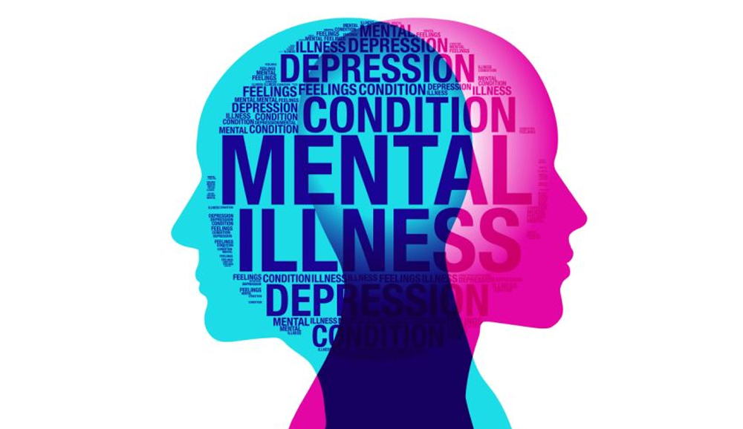
BACKGROUND
Data sourced from: https://zindi.africa/competitions/basic-needs-basic-rights-kenya-tech4mentalhealth
Low-income countries have an estimated treatment gap of 85% (as compared with high-income countries with a gap of 35% to 50%).
While Kenya has a mental illness prevalence rate that is comparable to that of high-income countries, there are still less than 500 healthcare professionals serving the country.

Slide 4
overview
Mental health issues among university students are a growing concern, often leading to severe consequences if not identified and addressed in time.
However, many students struggle to seek help due to stigma or lack of awareness. Traditional methods of mental health assessment require direct intervention, which may not always be feasible.
Key Objectives:
1. Text Classification: Develop a deep learning model to classify students’ statements into relevant mental health categories.
2. Probabilistic Predictions: Output a probability score for each category to indicate the likelihood of each mental health issue.

Slide 5
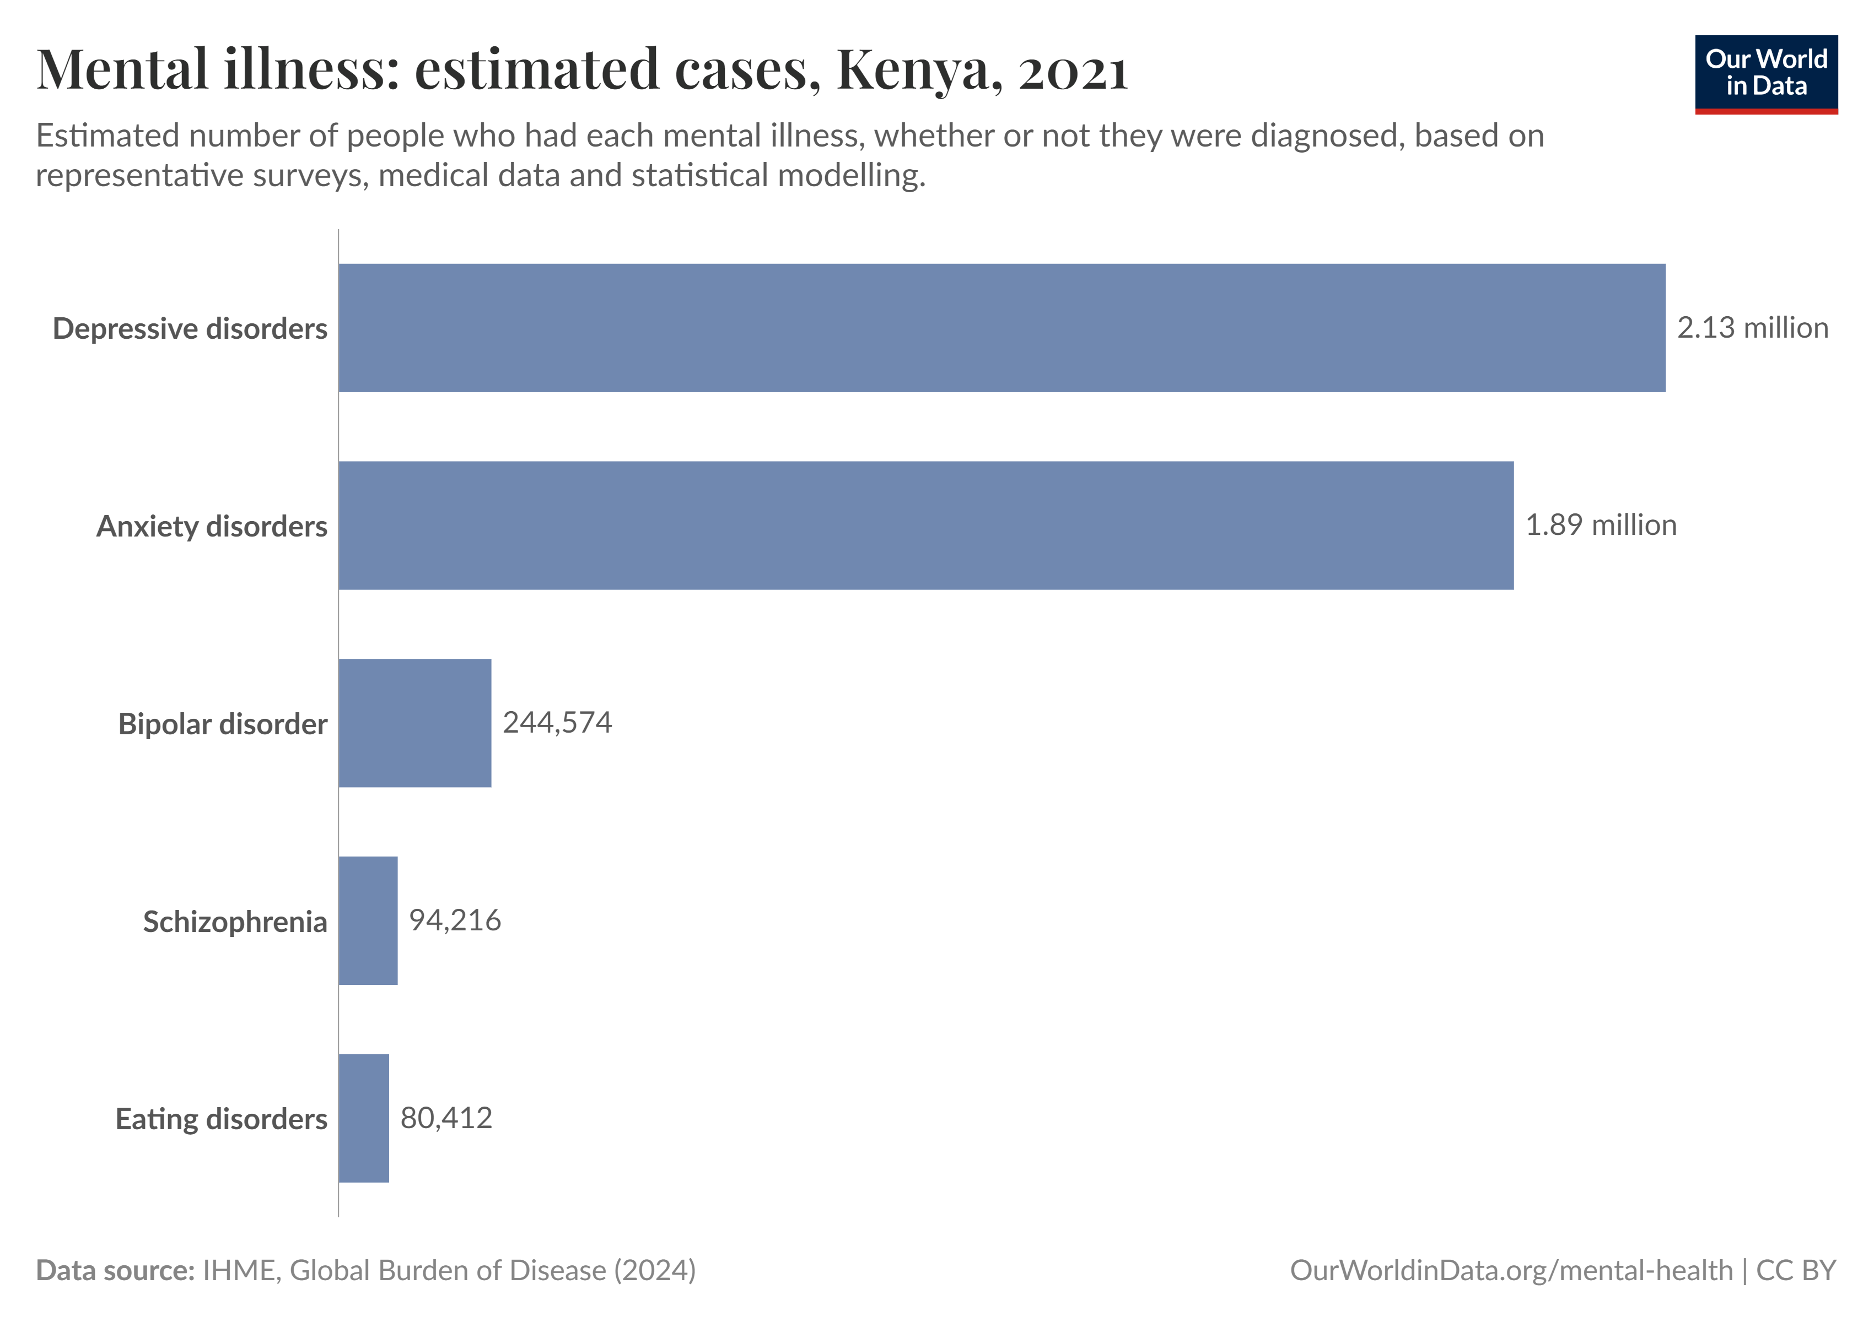

Slide 6
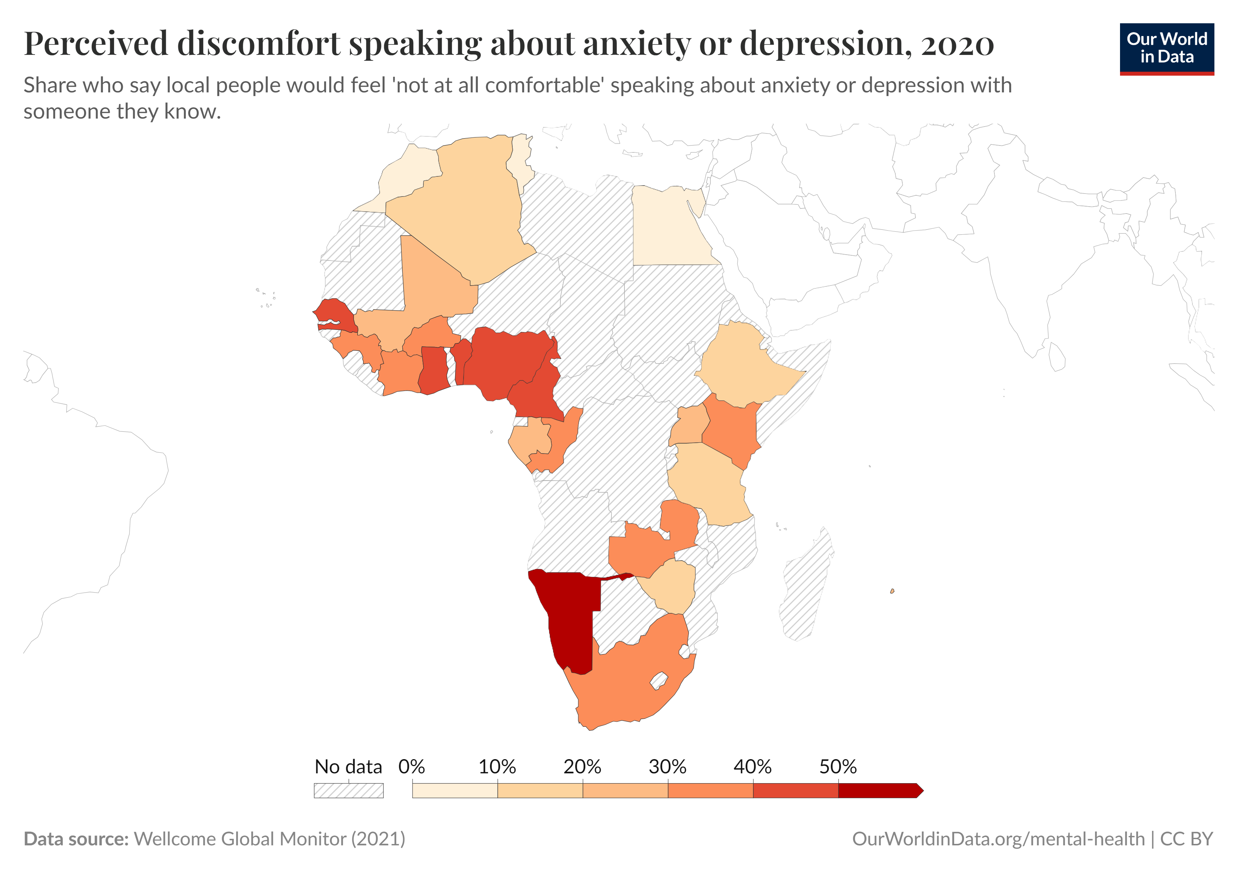

Slide 7
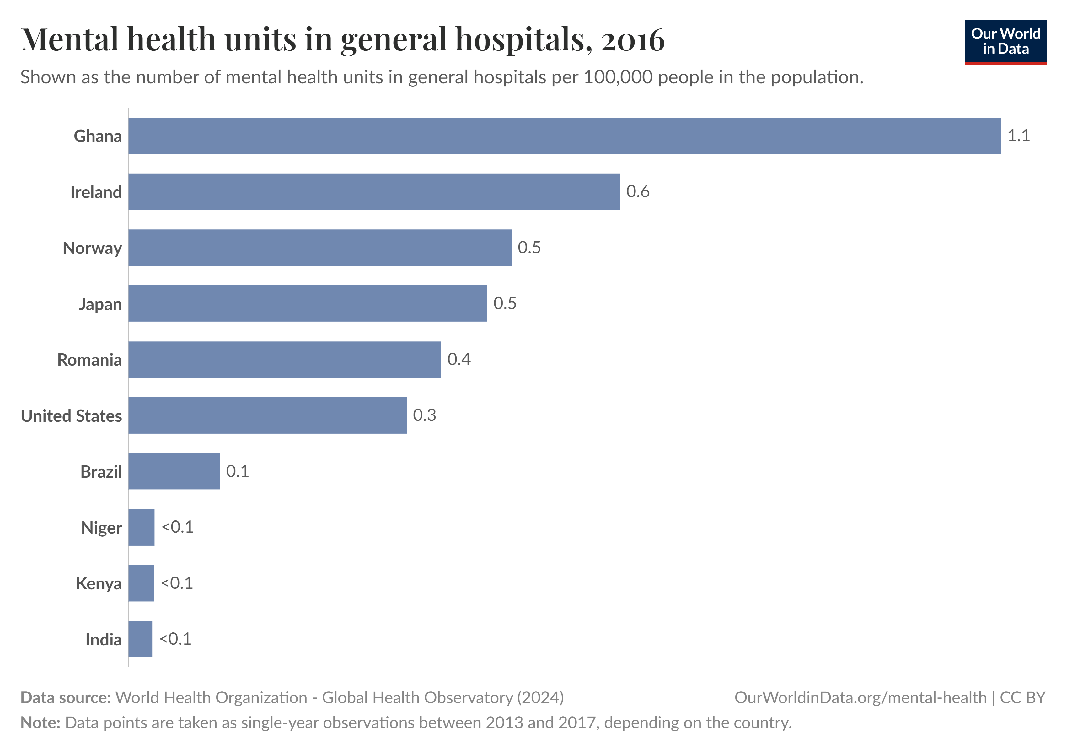

Slide 8
Dataset overview
Train dataset: 616 entries
Test dataset: 309 entries

Slide 9

Data preprocessing
Text preprocessing: lowercasing, removal of punctuation and stop words
synonym Augmentation: helps resolve class imbalance and robust
Padding and truncation: Ensures consistent input size
Tokenize: Simplifies text analysis
Encoding Labels: (Alcohol, Depression, Suicide and Drugs)
Set of techniques used to artificially increase the amount of data by generating new data points from existing data.
Original: How can I overcome alcoholism?
Augmented: get_the_better_of alcoholism
Process of converting a sequence of texts into smaller units called tokens for training classification models
Tokenization Example:
Original: get_the_better_of alcoholism
Tokenized: [6, 15, 8, 16, 29]

Slide 10
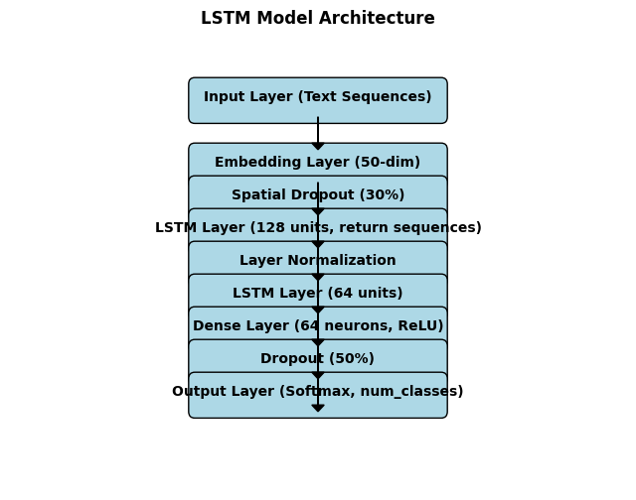
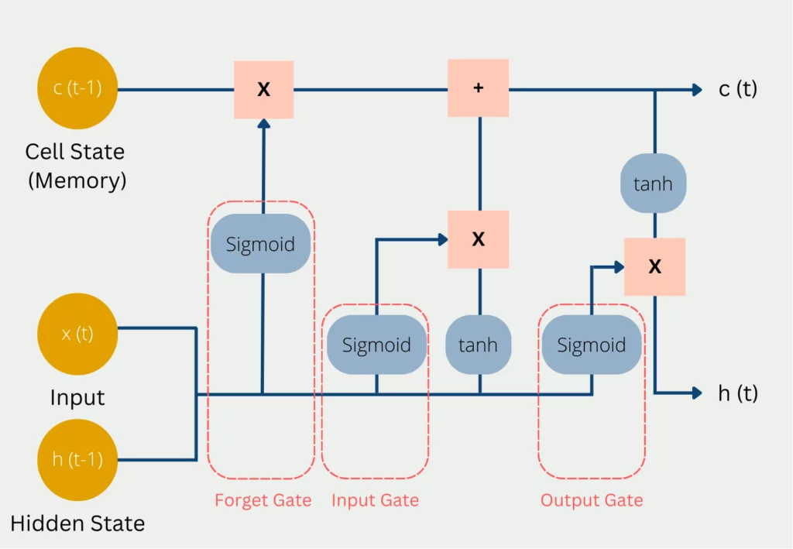
MODEL ARCHITECTURE
1. LONG SHORT TERM MEMORY (LSTM)
Is a type of RNN that is capable of learning long term dependencies.
Has 4 interacting layers

Slide 11
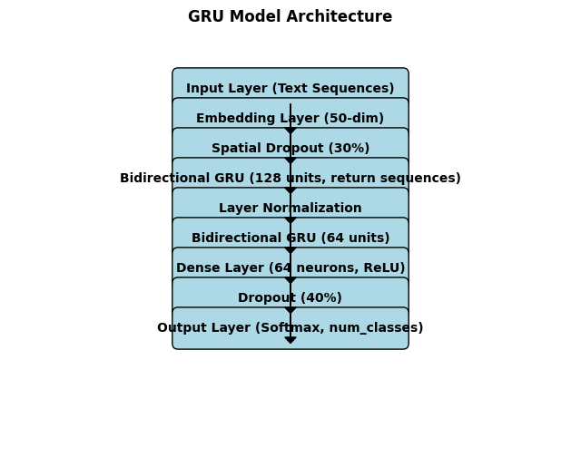
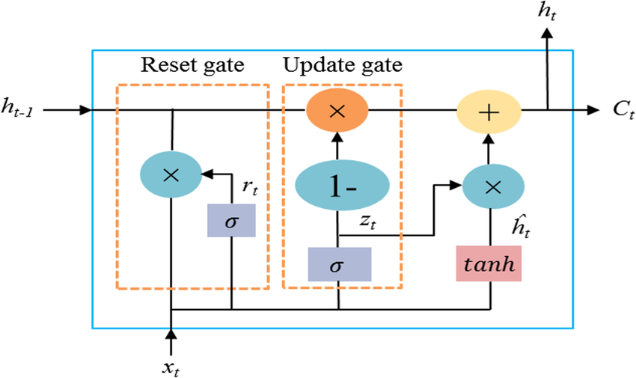
2. GATED RECCURENT UNIT(GRU)
Is variation of LSTM as they both have design similarities except that the GRU has an update and reset gate as well as doesn’t have a cell state, only has a hidden state.

Slide 12
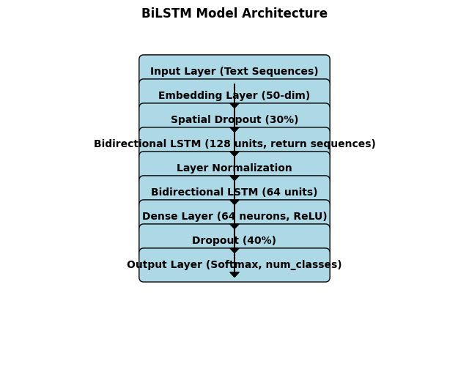
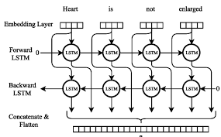
3. Bidirectional LSTM (BiLSTM)
Type of RNN that processes sequential data in both forward and backward directions simultaneously.

Slide 13
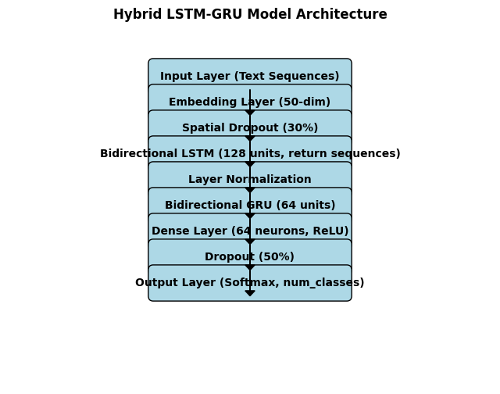

Slide 14
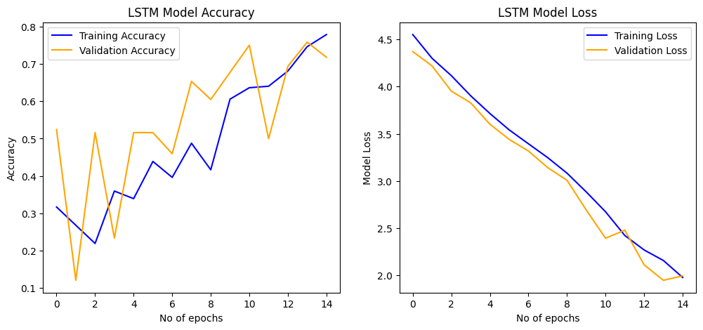
Model training and evaluation

Slide 15
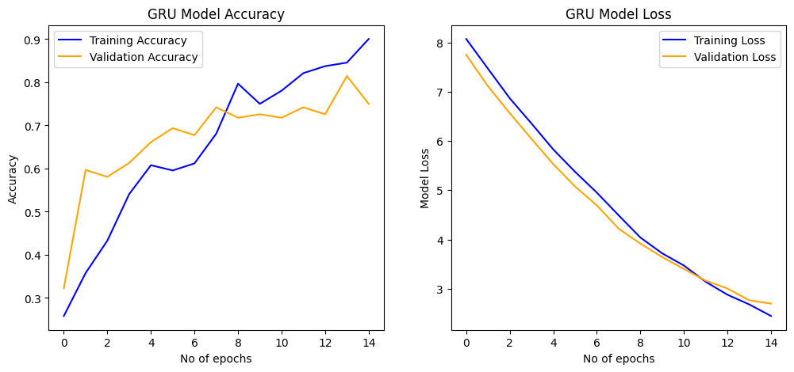

Slide 16
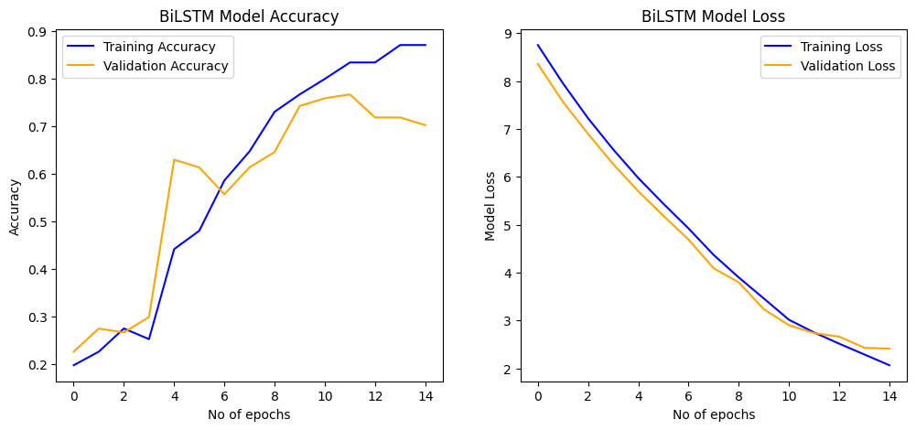

Slide 17
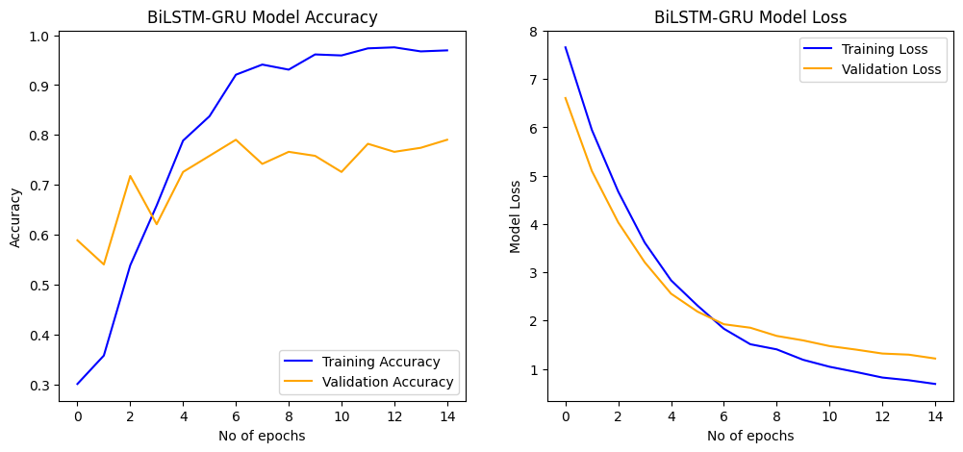

Slide 18
Evaluation
20/20 ━━━━━━━━━━━━━━━━━━━━ 1s 37ms/step - accuracy: 0.8919 - loss: 1.7310 lstm model loss and accuracy:[1.8090479373931885, 0.8538960814476013] 20/20 ━━━━━━━━━━━━━━━━━━━━ 1s 67ms/step - accuracy: 0.9494 - loss: 2.2693 bilstm model loss and accuracy:[2.342634439468384, 0.899350643157959] 20/20 ━━━━━━━━━━━━━━━━━━━━ 1s 59ms/step - accuracy: 0.9760 - loss: 2.3369 gru model loss and accuracy:[2.420685052871704, 0.9334415793418884] 20/20 ━━━━━━━━━━━━━━━━━━━━ 1s 64ms/step - accuracy: 0.9794 - loss: 0.6304 hybrid model loss and accuracy:[0.7157793641090393, 0.9464285969734192]
The hybrid model (LSTM+GRU) had the best performance with an accuracy of 94.64% and a loss of 0.71

Slide 19
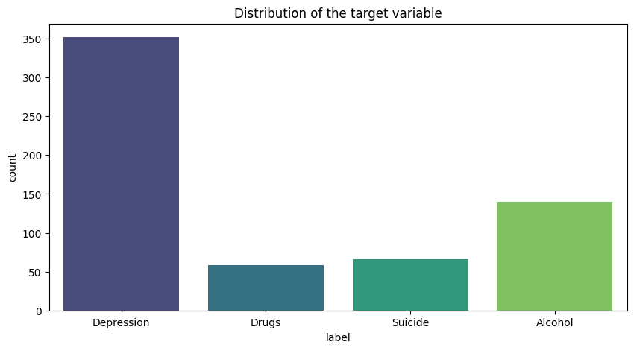
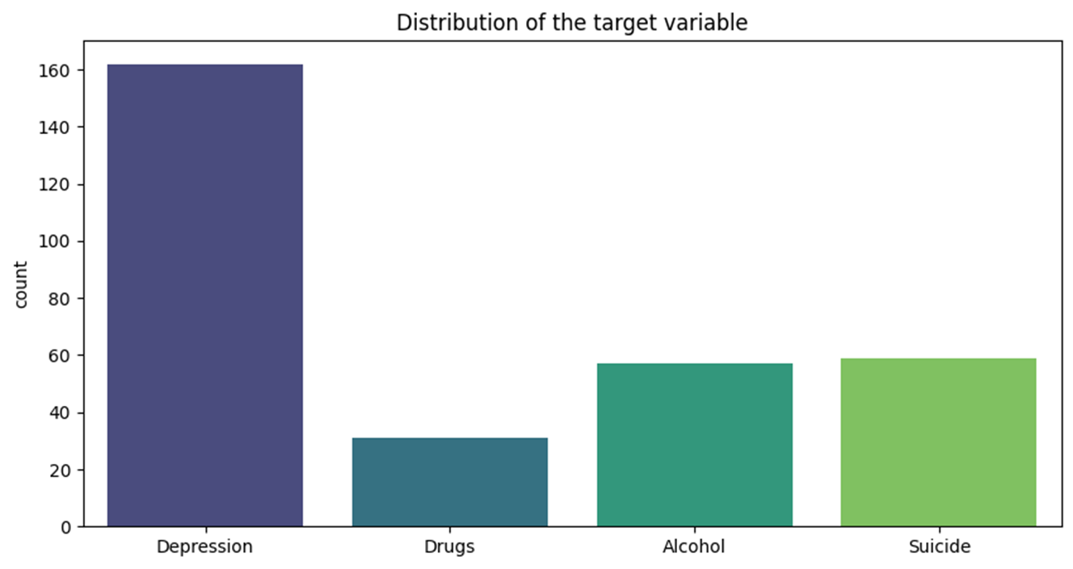
Results

Slide 21
CONCLUSION
Scalability & Real-world Application: Deployment of the model that can be used in chatbots, online counseling services, or automated mental health screening tools.

